Slide 1


Dollar Tree Enterprise Service Layer:
Initial Discovery Approach

Slide 2
MVP Integration
Landscape and ESL Operating Model

Slide 3
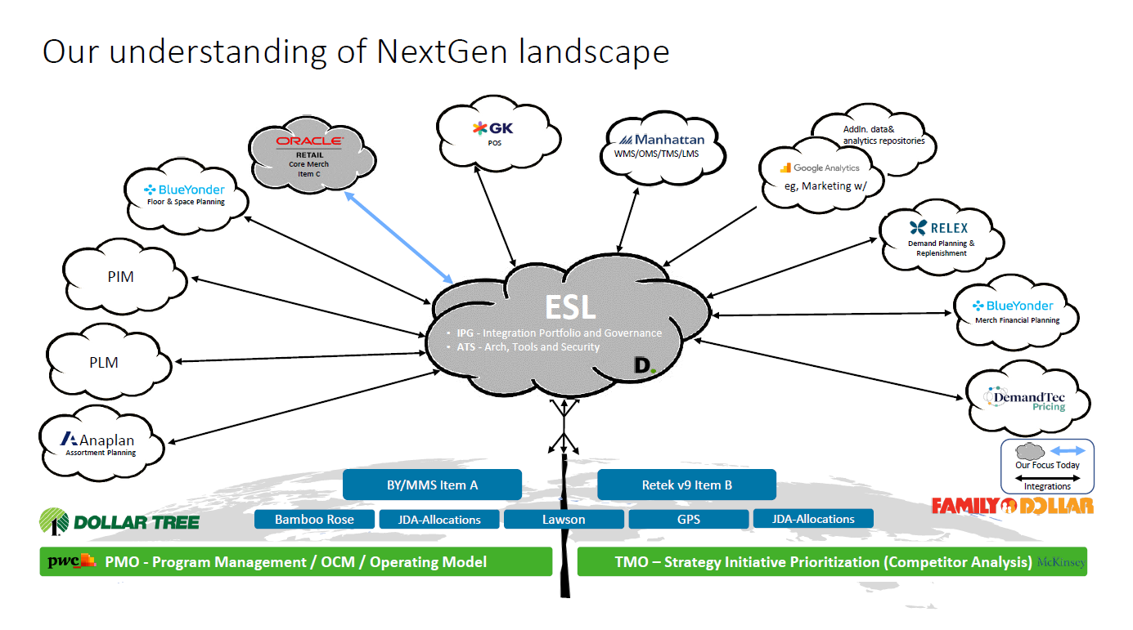

Slide 4
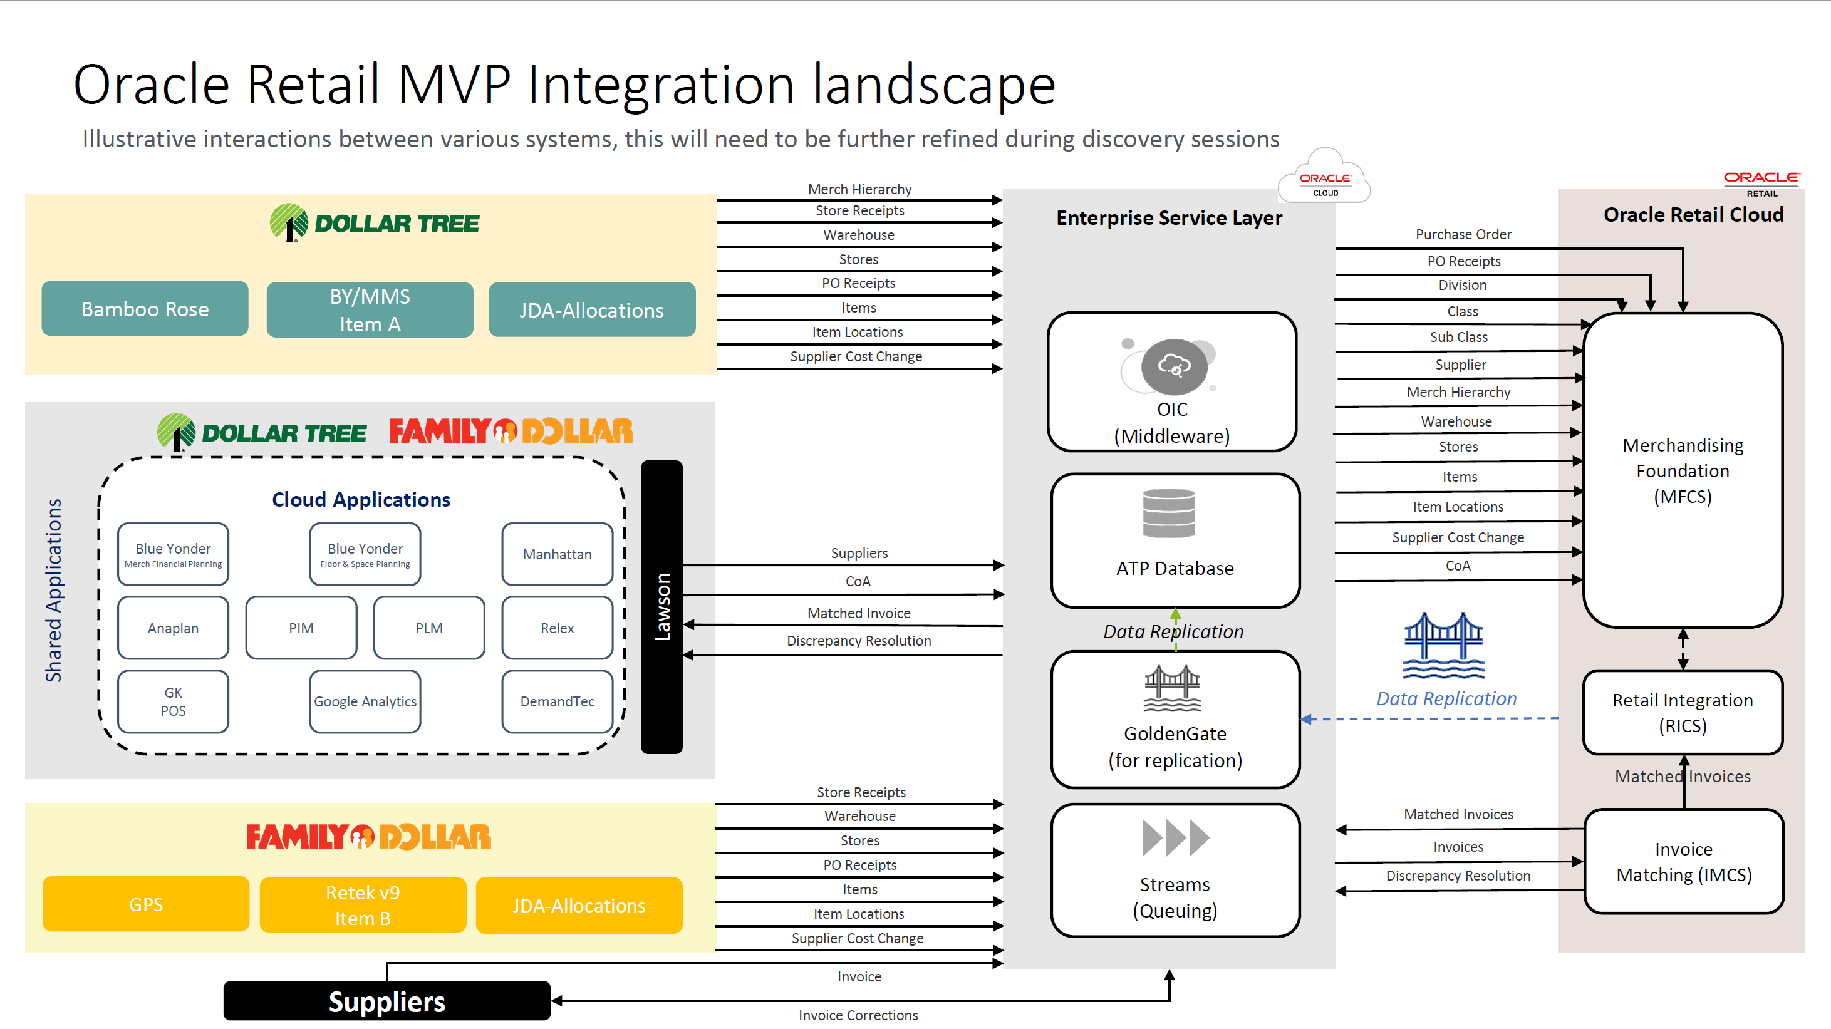

Slide 5
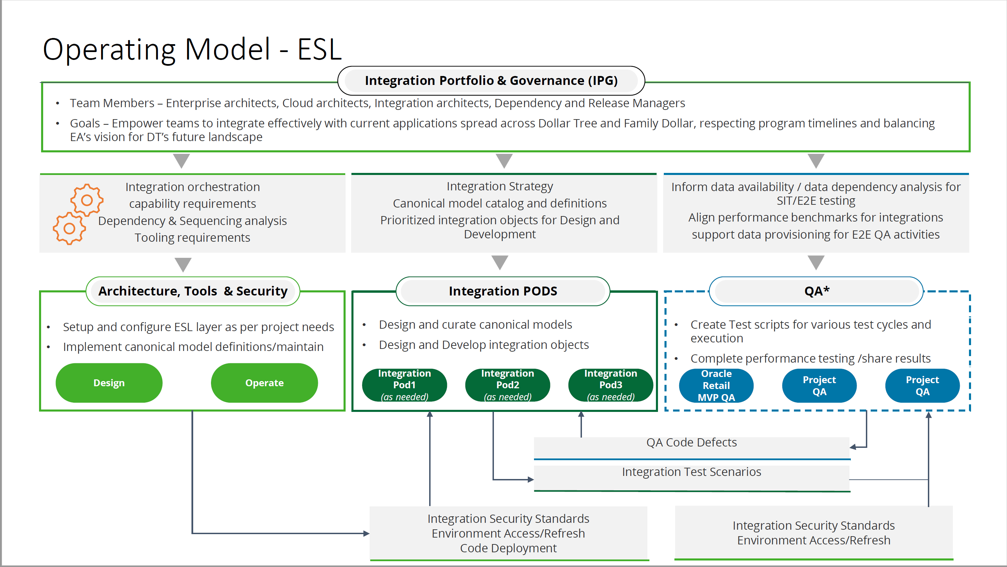

Slide 6
Oracle Retail MVP Timeline (8 Months assuming March 27 Start Date)
Proposed Development Start: March 27 2023 | March | April | May | Jun | Jul | Aug | Sep | Oct | Nov
Oracle MVP Timeline
Solution Overview
Design Sprints
Configure & Build
Sprints (4 -5 weeks each)
SIT
Performance Testing
Train The Trainer
UAT
Dry Run 0
Dry Run 1
Dry Run 2
Dry Run UAT
Cutover
MVP1 Go-Live
Key dependencies across workstreams to ensure environments are prepared and integration development can start in week 6:
Workstream | Week 1 | Week 2 | Week 3 | Week 4 | Week 5
Dollar Tree | Discovery workshops Kickoff |  | LZ Build START LZ Design submitted for Approval | Integration patterns Approvals LZ build support network & IAM | Process and Integration Scope approved
Oracle | Knowledge Session Kickoffs | Foundation workshops complete for Drop 1 Foundation Design Start |  | Oracle Provide Development Environment for MFCS | Process and Integration Scope completed Functional specs – Drop 1
Integration Portfolio Governance (IPG) | ESL Operating Model team Engaged ESL Standards and Requirements | Decision on DevOps Tooling Integration Patterns Identified for MVP |  | MVP impacted Application integration strategy - DRAFT | Integration Strategy Approval
Arch Tools and Security (ATS) |  | OIC Coding Starts | Dev Env. Released Dev Ops Tools built |  | Dev Env. Config Dev Ops Config
Integration Pod (IPODs) |  |  | Code Review Checklist Complete |  | Golden gate – configuration complete Development Ready to Start

Slide 7
MVP Timeline

Slide 8
IPG
Integration Portfolio Governance

Slide 9
Initial 4 week Discovery Plan - IPG
Establish IPG Program Plan, Strategies and Practices, Dev Ops processes and preliminary Integration architecture required to support the Transformation Program for Dollar Tree and kickstart the MVP.
Key Discovery Activities | Dependencies | Deliverables and Decisions
W1: Understand timelines of ongoing NextGen initiatives and EA vision of the Transformation Plan and Program Level priorities W2: Agree requirements for Program CICD process and DevOps tooling for the ESL W2: Review Integration Patterns and Draft MVP Application Integration Strategy W3: Begin documenting integration landscape and canonical models to support MVP plan W1 - 4: Assist in development of integrated MVP Sprint Plan | Scope of MVP Business Processes Application and Data Scope / Segmentation for MVP Drop 1 of Functional Specifications | Approved Integration Patterns for MVP Drop 1 Preliminary Design and Build Sequence for MVP Draft Canonical models and Integration Strategy for MVP

Slide 10
IPG MVP Kickoff Sessions
WK | Focus Area | Expected Outcomes | Attendees | Inputs Required | Est. Duration
1 | Knowledge Session: ESL Operating Model Kickoff | Introduce ESL Operating Model Socialize scope of the MVP Introduce Integration Patterns High-level ESL Architecture Establish roles and responsibilities Establish cadence and ways of working | Enterprise Architects ESL Workstream Leads | Program Kickoff | 2 Hours
1 | Knowledge Session: DevOps Process and Toolsets | Present approach to Integration build and configure Propose DevOps toolsets and CICD concepts Agree Requirments and Design Process | Enterprise Architects ESL Workstream Leads Future State Leads Legacy Owners |  | 2 Hour
1 - 4 | Working Sessions: Integration Discovery | ESL specific strategy sessions aligned to discovery schedule Formulate conceptual Data Models Develop Integration Strategy | Enterprise Architects | Discovery Sessions Legacy | Periodic to align with overall Discovery Workshops
4 | Approval Session: MVP Integration Strategy | Agreed Integration strategy and patterns Preliminary Data Models MVP Integration Landscape Sprint Sequencing Release and Capacity Plans | Enterprise Architects ESL Workstream Leads Future State Leads Legacy Owners | Approved DevOps Process Partner resourcing and capacity plans | 2 Hours
5 | Governance: MVP Drop 1 Design Approval | Approve scope and approach for Sprint 1 functional specifications | To be agreed | Approved Integration strategy Drop 1 Functional Specifications Infrastructure in place | 4 hours

Slide 11
ATS
Architecture Tools & Security

Slide 12
Initial 4 week Discovery Plan - IPG
Establish IPG Program Plan, Strategies and Practices, Dev Ops processes and preliminary Integration architecture required to support the Transformation Program for Dollar Tree.
Key Discovery Activities | Dependencies | Deliverables and Decisions
W1: Understand timelines of ongoing NextGen initiatives and EA vision of the Transformation Plan and Program Level priorities W2: Establish requirements for Program CICD process, Integration Patterns, Requirements gathering process, Tool Sets across partners W2: Agree design principles, integration patterns, data classifications W2: Capture MVP Architecture and Environment Requirements W3: Catalog integration landscape and proposed sprint plan W1 - 4: Assist in development of integrated MVP Project Plan | Agreement of Business Process Taxonomy Scope of MVP Business Processes Data Scope / Segmentation for MVP agreed by all Partners Drop 1 of Functional Specifications | Draft Canonical Models and Data Definitions for MVP Scope Preliminary Design and Build Sequence Proposed Non Prod Architecture and timeline dependencies
To be updated with Track Specific details

Slide 13
Sessions Agenda: Week 2
WK | Focus Area | Expected Outcomes | Attendees | Inputs Required | Est. Duration
2 | Familiarization Session: Foundations Organizational Hierarchy | Confirm and validate functional scope of the Merchandising Cloud Service (MCS) solution Validate decisions for key solution choices Identify and assess high-level business impacts Enable 60% completion of system configuration Build a greater understanding of how business users will interact with the system | DT & FD Core Business and Project Team: IT, Data Governance, Merchandising/Purchasing, E-Comm, Finance, AP, Store and DC Operations |  | 4 hours
2 | Familiarization Session: Vendor/Supplier |  | DT & FD Core Business and Project Team: IT, Data Governance, Merchandising/Purchasing, E-Comm, Finance, AP |  | 4 hour
 |  |  |  |  | 6 hours
2 | Familiarization Session: Technical Overview and Technical Integration | High-Level technical understanding of MFCS: Data Migration – Requirements and Tools Integration – Patterns and Default Interfaces Security – Applications and Infrastructure Batch and Integration with other systems | DT & FD Project Team: IT |  | 4 hours
2 | Familiarization Session: Environment Strategy and Security | Understanding of: Oracle Retail Security Architecture & Access Control MFCS Environment Provisioning and Upgrade and Initial Write-up of MOM Environment Plan for MVP and ED | DT & FD Project Team: IT |  | 6 hours
2 | Preparation Session: Data Conversion | Understanding of data conversion activities such as (but not limited to) Source and Target Systems Analyse Merch Legacy Application Data Model Data Cleansing requirements before migration Data Volume considerations Etc. | DT & FD Project Team: IT |  | 2 hours
To be updated with Track Specific recommendation for planned sessions

Slide 14
IPODs
Integration PODs
& QA

Slide 15
Initial 4 week Discovery Plan – IPOD & QA
Establish IPG Program Plan, Strategies and Practices, Dev Ops processes and preliminary Integration architecture required to support the Transformation Program for Dollar Tree.
Key Discovery Activities | Dependencies | Deliverables and Decisions
W1: Participate in scope review sessions conducted by Oracle W1-2: Review Existing Landscape, identify source systems and POC for channels in scope, W2-3: work with Oracle, Dollar Tree & Family Dollar to finalize the integration scope for MVP, Plan for data mapping sessions, finalize plan for rest of the phases based agreed scope. W4: Work with IPG team to finalize the no. of PODs, initiate onboarding or additional PODs. Based on Oracle functional specs, start data mapping sessions. Review/Finalize coding standards Test strategy, alignment on tools for QA and metrics | First drop of integration functional specs (4 integrations) from Oracle by April end Finalize Coding standards by end of April Environment strategy is finalized by mid April Decision on CICD tool , alignment on environment deployment plan alignment with deployment plan Current system SME availability for scope review /data mapping discussions. Integrations scope will be finalized in the first couple of weeks of scope review sessions to help integration planning efforts Environment deployment is finalized and aligned with development plan | List of integrations scope for Oracle Retail MVP Test Strategy

Slide 16
Sessions Agenda: Week 2
WK | Focus Area | Expected Outcomes | Attendees | Inputs Required | Est. Duration
2 | Familiarization Session: Foundations Organizational Hierarchy | Confirm and validate functional scope of the Merchandising Cloud Service (MCS) solution Validate decisions for key solution choices Identify and assess high-level business impacts Enable 60% completion of system configuration Build a greater understanding of how business users will interact with the system | DT & FD Core Business and Project Team: IT, Data Governance, Merchandising/Purchasing, E-Comm, Finance, AP, Store and DC Operations |  | 4 hours
2 | Familiarization Session: Vendor/Supplier |  | DT & FD Core Business and Project Team: IT, Data Governance, Merchandising/Purchasing, E-Comm, Finance, AP |  | 4 hour
 |  |  |  |  | 6 hours
2 | Familiarization Session: Technical Overview and Technical Integration | High-Level technical understanding of MFCS: Data Migration – Requirements and Tools Integration – Patterns and Default Interfaces Security – Applications and Infrastructure Batch and Integration with other systems | DT & FD Project Team: IT |  | 4 hours
2 | Familiarization Session: Environment Strategy and Security | Understanding of: Oracle Retail Security Architecture & Access Control MFCS Environment Provisioning and Upgrade and Initial Write-up of MOM Environment Plan for MVP and ED | DT & FD Project Team: IT |  | 6 hours
2 | Preparation Session: Data Conversion | Understanding of data conversion activities such as (but not limited to) Source and Target Systems Analyse Merch Legacy Application Data Model Data Cleansing requirements before migration Data Volume considerations Etc. | DT & FD Project Team: IT |  | 2 hours
To be updated with Track Specific recommendation for planned sessions

Slide 17
Thank you
ABOUT DELOITTE
Deloitte refers to one or more of Deloitte Touche Tohmatsu Limited, a UK private company limited by guarantee (“DTTL”), its network of member firms, and their related entities. DTTL and each of its member firms are legally separate and independent entities. DTTL (also referred to as “Deloitte Global”) does not provide services to clients. In the United States, Deloitte refers to one or more of the US member firms of DTTL, their related entities that operate using the “Deloitte” name in the United States and their respective affiliates. Certain services may not be available to attest clients under the rules and regulations of public accounting. Please see www.deloitte.com/about to learn more about our global network of member firms. Copyright © 2023 Deloitte Development LLC. All rights reserved.

Slide 18
IPG Discovery Schedule
Phase | Activities | Owner | Target Week | Expected Outcome/ Deliverables
Discovery | Participate in Program Kickoff, Understand NextGen Initiatives and scope of future state transformation programs | Geoff/ Shankar | W1 | Common understanding of NextGen scope and Approach
 | Understand the current landscape, Enterprise Architecture vision for future state, key stakeholders of current and NextGen Apps | Geoff/ Shankar | W1 | Identify key stakeholders, current system owners and to be system landscape
 | Understand the Scope, Milestones and CSFs for the MVP | Geoff | W2 | Identified dependencies and critical path milestones across process, systems and partners for MVP
 | Participate in workshops and collect inputs for preliminary data dictionary and canonical models required to support MVP Scope | Geoff | W1 - 4 | Present ways of working, roles and responsibilities and
 | Prepare conceptual integration landscape and release plan for MVP and Milestone Plan for NextGen initiatives | Geoff | W3-4 | MVP Release Plan NextGen Transformation Plan
 | Hold Kick off for IPG Define IPG strategies and practices, Dev Ops processes and Integration governance | Geoff/Shankar | W4 | Agree Integration Design And Build Approach, Finalize the tool set (CICD /QA/Program management)

Slide 19
Timeline
Key Activities
Deliverables
Cross-Team Meeting
Steering Co Meetings
Sprints
Critical Check points Steering Co
Proposed Development Start: March 27 2023 | March | April | May | Jun | Jul | Aug | Sep | Oct | Nov
Timeline
IPG – Integration Portfolio Governance
ATS - Arch Tools and Security
IPODS – Integration Pod
RIT – Retail system Integration and QA Testing
Oracle
Dollar Tree
Solution Overview
Design Sprints
Configure & Build
Sprints (4 -5 weeks each)
SIT
Performance Testing
Train The Trainer
UAT
Dry Run 0
Dry Run 1
Dry Run 2
Dry Run UAT
Cutover
MVP1 Go-Live
PMO
Strategies & Standards
CICD Setup and Code Review Checklist
Testing Approach & Boundary Readiness
SIT & Performance Sign Off
Cutover Plan & KT Plan
UAT Sign Off
Cutover Go Ahead
Initiate KT
CICD requirements/standards, tooling
OCI Landing Zone Design
Review strategy and integration arch
Code Build and Unit Testing
Cutover Support
Test Cycle Support
Hypercare
Review Solution and test plan
Functional Testing
INT Prep & Exec; UAT Prep
UAT Exec & Cutover Prep
Assist Cutover, Smoke test
Test scripts Preparation
Identify Integrations
Execute Process Testing Cycle and Support Integration testing
Design Functional Spec & Inputs to Data Mapping
Assist Cutover
Support Hypercare
Existing Process Walkthrough
Inputs to Data Mapping
SIT Support
UAT Execution
Assist Cutover
Retrofit existing programs (If required)

Slide 20

8 Week Deliverables/Milestones/Dependencies
Proposed Development Start: March 27 2023 | 3/27 Kick off week | 4/3 Week 1 | 4/10 Week 2 | 4/17 Week 3 | 4/24 Week 4 | 5/1 Week 5 | 5/8 Week 6 | 5/15 Week 7 | 5/22 Week 8
Dollar Tree – Key Milestones
Oracle
IPG – Integration Portfolio Governance
ATS - Arch Tools and Security
IPODS – Integration Pod
RIT – Retail system Integration and QA Testing
5/8 -Process and Integration Scope approved
4/24
Development environment for Oracle MCS - Released
5/1 -Process and Integration Scope completed
Functional specs – Drop 1
5/15 -
Functional specs – Drop 2
4/24– MVP impacted Application integration strategy - DRAFT
5/8– Integration
strategy Approval
5/15
Netgen initiative – Consolidated milestone view
4/10- Decision on Dev/Ops tooling
4/17- Integration patterns –DrAft Complete
5/1- Integration patterns Approvals
4/14 DevOps
Tool
4/17
LZ Architecture
Approval
4/20
LZ build support network & IAM
3/27
1.Workshop scheduled
3/3
1Standards & requirements
4/10
1.Foundation - workshops complete
2.Foundation Design START
4/17
1.LZ Build START
2.LZ Design
submitted for Approval
4/28
1. Dev Env. Released
2.Dev Ops built
5/5
1.
4/10
1.OIC coding starts
5/1
Data mapping Start
4/24
Code review checklist- Complete
5/8
Development Start
Golden gate – configuration complete

Slide 21
Initial 4 week Discovery Plan - IPG
Empower teams to integrate effectively with current applications spread across Dollar Tree and Family Dollar, coordinating program timelines and balancing EA’s vision for DT’s future landscape
Key Discovery Activities
Deliverables and Decisions
Understand timelines of ongoing NextGen initiatives
Review existing landscape & understand Enterprise Architecture vision for the future landscape
Consult with DT and Oracle teams on MVP Scope and data flows
Consult with enterprise architecture teams and align on current application retirement timelines
Preliminary Integration Sprint Plan for IPOD teams
NextGen initiatives with milestones
Application Inventory with dispositioning (Current & NextGen)
Draft Canonical Models for MVP Scope
Draft Data Flows for MVP scope
ATS Timeline and environment needs
Dependencies
Assumptions
Agreement of Business Process Taxonomy
Scope of MVP business Processes
Data Scope / Segmentation for MVP agreed by all Partners
Partner Timelines and Resource Plans
MVP DSD Scope will be aligned to an agreed subset of products / stores / vendors
Store Systems are not in scope for the MVP

Slide 22
IPG Discovery Schedule
Phase | Activities | Owner | Target Week | Expected Outcome/ Deliverables
Discovery | Hold soft kick off for IPG | Geoff/ Shankar | W1 | Identify key stakeholders, current system
 | Understand the current landscape, vision for future state, key stakeholders of current and NextGen Apps | Geoff/ Shankar | W2 | Identify the current system landscape and to be system landscape
 | Understand the NextGen apps and milestones and retirement plan for existing systems | Geoff | W2 | Understand the dependencies across various connect
 | Identify the dependences across NextGen apps | Geoff | 03/30/2023
 | Hold Kick off for IPG | Geoff/Shankar | 04/08/2023
 | Prepare dependency plan for NextGen initiatives | Geoff | W4 | Dependency/Milestone plan
 | Conduct sessions to finalize the tool set (CICD /QA/Program management) | Geoff | 03/27/2023
Notes:
Inputs/dependencies from Dollar Tree and by when.

Slide 23
Sessions Agenda: Week 2
WK | Focus Area | Expected Outcomes | Attendees | Est. Duration
2 | Familiarization Session: Foundations Organizational Hierarchy | Confirm and validate functional scope of the Merchandising Cloud Service (MCS) solution Validate decisions for key solution choices Identify and assess high-level business impacts Enable 60% completion of system configuration Build a greater understanding of how business users will interact with the system | DT & FD Core Business and Project Team: IT, Data Governance, Merchandising/Purchasing, E-Comm, Finance, AP, Store and DC Operations | 4 hours
2 | Familiarization Session: Vendor/Supplier |  | DT & FD Core Business and Project Team: IT, Data Governance, Merchandising/Purchasing, E-Comm, Finance, AP | 4 hour
 |  |  |  | 6 hours
2 | Familiarization Session: Technical Overview and Technical Integration | High-Level technical understanding of MFCS: Data Migration – Requirements and Tools Integration – Patterns and Default Interfaces Security – Applications and Infrastructure Batch and Integration with other systems | DT & FD Project Team: IT | 4 hours
2 | Familiarization Session: Environment Strategy and Security | Understanding of: Oracle Retail Security Architecture & Access Control MFCS Environment Provisioning and Upgrade and Initial Write-up of MOM Environment Plan for MVP and ED | DT & FD Project Team: IT | 6 hours
2 | Preparation Session: Data Conversion | Understanding of data conversion activities such as (but not limited to) Source and Target Systems Analyse Merch Legacy Application Data Model Data Cleansing requirements before migration Data Volume considerations Etc. | DT & FD Project Team: IT | 2 hours
To be updated

Slide 24
Timeline
Key Activities
Deliverables
Cross-Team Meeting
Steering Co Meetings
Sprints
Critical Check points Steering Co
Rita - ATS
Overall Timeline is of 8 Months considering a start on 3/27
Proposed Development Start: March 27 2023 | March | April | May | Jun | Jul | Aug | Sep | Oct | Nov
Timeline
IPG – Integration Portfolio Governance
ATS - Arch Tools and Security
IPODS – Integration Pod
RIT – Retail system Integration and QA Testing
Oracle
Dollar Tree
Solution Overview
Design Sprints
Configure & Build
Sprints (4 -5 weeks each)
SIT
Performance Testing
Train The Trainer
UAT
Dry Run 0
Dry Run 1
Dry Run 2
Dry Run UAT
Cutover
MVP1 Go-Live
PMO
Strategies & Standards
CICD Setup and Code Review Checklist
Testing Approach & Boundary Readiness
SIT & Performance Sign Off
Cutover Plan & KT Plan
UAT Sign Off
Cutover Go Ahead
Initiate KT
CICD requirements/standards, tooling
OCI Landing Zone Design
Dev environment ready
Devops/CICD tool setup
Test environment
Review strategy and integration arch
Code Build and Unit Testing
Cutover Support
Test Cycle Support
Hypercare
Review Solution and test plan
Functional Testing
INT Prep & Exec; UAT Prep
UAT Exec & Cutover Prep
Assist Cutover, Smoke test
Test scripts Preparation
Identify Integrations
Execute Process Testing Cycle and Support Integration testing
Design Functional Spec & Inputs to Data Mapping
Assist Cutover
Support Hypercare
Existing Process Walkthrough
Inputs to Data Mapping
SIT Support
UAT Execution
Assist Cutover
Retrofit existing programs (If required)

Slide 25
Timelines, Activities & Deliverables –Integration POD to support Oracle Retail MVP
Months
0
1
2
3
4
5
6
7
8
Timeline
Discover
Iterative Design
Iterative Build
Test
Run
Discover
Design
Build
Testing/Go-live preparation
Post Go-live
Participate in scope review sessions & Finalize scope for POD
Review Coding Standards
Review Existing Landscape
Capture technical requirements & data mapping with current and Retail applications stakeholders
Write lean design specifications
Perform Initial POC’s for connectivity testing
Establish CICD pipeline for Code promotions
Validate integrations in RICE list
Design & curate initial canonical models for Retail MVP
Develop code build
Document test plan
Execute test scripts and conduct unit testing
Review results against agreed test cases
Batch schedule preparation
Support System integration test cycles
Support End to End test cycles
Support UAT test cycle
Support Performance testing
Participate in defect triaging and perform defect fixes
Provide inputs for cutover plan
Perform Smoke testing
Finalize hyper care approach
Support Application Go Live
Post-production defect fixes
Conduct knowledge transfer sessions
Activities
Deliverables
Approved integration scope
Data mapping and Technical Specification
Code Bundle
Unit Test Plan & Results
Cut over plan – Integration
Defect fix
Hypercare approach
Go-live report
Knowledge Transfer Documents

Slide 26
Timelines, Activities & Deliverables – Oracle Retail MVP QA
Months
0
1
2
3
4
5
6
7
8
Timeline
Discover
Iterative Design
Iterative Build
Test
Run
Discover
Design/Build
Testing/Go-live Preparation
Post Go-live
Participate in process & MVP Scope sessions
Define QA framework & metrics
Define automation framework
Participate in design review sessions
Prepare Test strategy
Document system integration test scripts based on MVP process scenarios/user stories
Document End to End test scripts
Identify critical components for performance testing
Review existing and Identify test scenarios for automation
Automate scenarios identified for regression
Conduct System integration test cycles and report test results
Conduct End to End test cycles and report test results
Support UAT testing
Perform Performance testing and report test results
Review results against agreed Entry exit criteria
Defect Triaging, QA program and metrics reporting
Continue to automate scenarios identified for regression
Support Go-live
Perform Smoke testing
Review production defect fix/testing
Continue to automate scenarios identified for regression
Activities
Test Strategy
System Integration Test plan/scenarios
End to End test plan/scenarios
Performance test plan/scenarios
System integration test results
End to End test results
Performance testing results
Daily QA dashboard
Post-production QA metrics reporting
Deliverables

Slide 27
4 Weeks schedule/activities
Phase | Activities | Owner | Start | End | Expected outcome/deliverables
Discover | Collaborate with stakeholders to understand their requirements and ensure they are included in the scope of work | Functional Lead |  |  | A well-defined scope document that clearly outlines the goals, objectives, deliverables, and timelines for the project.
 | Ensure the scope is clearly defined and aligned with business goals. | Functional Lead
 | Review the scope document to ensure that it is technically feasible and achievable. | Technical Lead
 | Collaborate with the functional lead to identify potential technical risks and provide input on solutions. | Technical Lead

Slide 28
4 Weeks schedule/activities
Phase | Activities | Owner | Start | End | Expected outcome/deliverables
Discover | Finalize the Intergation Touch Points between Oracle and Legacy Applications | QA Lead (TBD) |  |  | Testing strategy document outlining the approach, scope, risks, timelines, and tools.
 | Tools and Resources that will be used for testing and reporting |  |  |  | Test plan document outlining the testing cycles, entry and exit criteria, and roles and responsibilities.
 | Identify the test data and team to support with data points |  |  |  | Test case documents outlining the scenarios, test steps, and expected results. Test execution reports detailing the status of each test cycle, including the number of test cases executed, passed, and failed. Defect reports detailing the defects identified during testing, including severity, priority, and status. Analytical reports detailing the test execution, test coverage, and defect trends. Daily QA dashboard providing a summary of the testing progress and status to stakeholders. Communication plan outlining the stakeholders, channels, and frequency of communication for Testing

Slide 29
Sessions Planned
WK | Focus Area | Expected Outcomes | Attendees | Est. Duration
1 | Alignment Session: Kickoff | The purpose of the kick-off meeting is to formally notify all project team members that the project has begun and make sure everyone has a common understanding of the project and their roles. Explain project objectives, scope, approach, governance, project team and timeline | DT & FD Business Sponsors DT & FD Core Business and Project Team: IT, Data Governance, Merchandising/Purchasing, E-Comm, Finance, AP, Stores and DC Operations | 2 hours
1 | Familiarization Session: Foundations Accounting | Confirm and validate functional scope of the Merchandising Cloud Service (MCS) solution Validate decisions for key solution choices Identify and assess high-level business impacts Enable 60% completion of system configuration Build a greater understanding of how business users will interact with the system | DT & FD Core Business and Project Team: IT, Data Governance, Merchandising/Purchasing, E-Comm, Finance, AP | 4 hours
1 | Familiarization Session: Foundations Organizational Hierarchy |  |  | 2 hours
1 | Preparation Session: Technical Integration Prep Session | Provide an overview of MFCS integration architecture and the out-of-the-box integration catalogue Create an understanding of each integration method and how it is used to integrate within Oracle Retail and external systems Facilitate discussion about DT/FD high level integration requirements Identify potential integration constraints | DT & FD Project Team: IT | 2 hours

Slide 30
Timelines, Activities and Deliverables – ESL IPG
Months
0
1
2
3
4
5
6
7
8
Timeline & Phases
Discover
Define
Empower
Discover
Define
Empower
Understand timelines of ongoing NextGen initiatives
Review existing landscape
Understand Enterprise architectures vision for the future landscape
Consult with enterprise architecture teams and align on current application retirement timelines
Laydown integration strategy inline with EA’s vision for the future
Define integration patterns
Define ESL responsibilities to service integration requests for NextGen initiatives
Establish cross initiative communication cadence to understand dependencies and flag risks
Define and catalog canonical models to service short term and long-term initiatives
Define strategy for handling PCI or other sensitive
Empower integration pods to design and develop according to standards
Empower ATS team to monitor security and architectural standards
Educate project teams on integration patterns and leverage canonical models to expedite value delivery
Monitor capacity across integration pods and highlight risks to NextGen program timelines
Review and Update Application Integration Strategy
Review and Update Data Integration Strategy
Review and Update Cross Technology Project Release Plan
Update Application Inventory
Activities
NextGen initiatives with milestones
Application Inventory with dispositioning (Current & NextGen)
Application Integration strategy
Data integration strategy (including initial canonical models)
Cross Technology Project Release Plan
Weekly IPG Status Report
Architecture Review Board (ARB) Playbook and Guidelines
Deliverables
Notes:
Highlight how IPG will be working with QA

Slide 31
4 Weeks schedule/activities (contd)
Phase | Activities | Owner | Start | End | Expected Outcome/ Deliverables
Discover | Specific Data related problems or challenges Data security and privacy requirements for the project |  |  |  | Analyze existing data sources and assess their quality and relevance. Begin developing a data strategy for handling sensitive data. Finalize the design and catalog of canonical data models. Establish governance policies for the usage of the canonical data models.

Slide 32
Sessions Planned
Week Starting | Focus Area | Expected Outcomes | Attendees | Est. Duration
27th March | Soft Kickoff | Review Short term/long term goals Scope, timeline, Roles, responsibilities alignment across teams Align on Agenda for kick-off and participants, schedule kick off | DT & FD Business & IT sponsors Enterprise Architect(s) | 2 hours
 | Familiarization sessions 1 | Understand Current landscape Identify NextGen initiatives and key milestones | Enterprise Architect(s) | 4 hours
 | Familiarization sessions 2 | Finalize the focus areas/priority list for initial weeks | Enterprise Architect(s) | 2 hours
 | Kick off Prep | Review the kick-off and alignment with core team before the actual kick-off | DT & FD Business & IT sponsors Enterprise Architect(s) | 2 hours
3rd April | Kick Off | Review Short term/long term goals Scope, timeline, Roles, responsibilities alignment across teams | DT & FD Business Sponsors DT & FD Core Business and Project Team: IT, Data Governance, Enterprise Architects, Solution Architects | 2 hours
 | Finalize Tools Session 1 | Discuss CICD tooling options and finalize | Enterprise Architects, Solution Architects | 2 hours
 | Finalize Tools Session 2 | Finalize QA tracking and automation tools | DT & FD QA team DT & FD NextGen POC | 2 hours

Slide 33
Detailed Timelines, Activities and Milestones : ESL-ATS
Stage 1
Stage 2
Phase 1:
Discover & Analyze
Phase 2:
Design
Phase 3:
Build non-Prod
Phase 1:
Analyze & Design
Phase 2:
Build Prod
Timeline
Months
0
1
2
3
4
5
6
7
8
Stage 1 Development & Test
Stage 2 (Production)
Compartment
Discover and Analyze
Design
Run & Maintain
Analyze & Design
Run & Maintain
Analyze Future State Architecture
Network Design
Draft Proposed Architecture
Backup & Recovery/DR Strategy
Requirements for Identity and Access Management
Review monitoring and audit requirements
Cyber security gaps and requirements
Review Architecture with Key Stakeholders
Finalize Development & Test Architecture Design
Configure OCI Tenancy
Implement Identity and Access Management
Configure Network Connectivity
Validate OCI Tenancy
Infrastructure and PaaS Security Controls
Deliverables signoff
Day-to-day monitoring and management
Environments management
Configuration & change management support
Performance & troubleshooting support
Cost optimization
Capacity management
DevOps, CI/CD
Backups
Access support
Documentation
Capture Sizing inputs
Finalize Production Configuration
Size Production
Finalize Production Architecture Design
Review Infrastructure & PaaS Security
Deliverables signoff
Day-to-day monitoring and management
Environments management
Configuration & change management support
Performance & troubleshooting support
Cost optimization
Capacity management
DevOps, CI/CD
Backups
Access support
Documentation
ATS Build-out
Deliverables
OCI Tenancy Architecture Design MVP
Network Design MVP
OCI & PaaS Security Design MVP
Build Development/Test
Deploy Platform Services (PaaS)
Secure Infrastructure & PaaS services
Environment Validation
Setup Backups, Monitoring & Auditing
Build Production
Deploy Platform Services (PaaS)
Secure Infrastructure & PaaS services
Environment Validation
Setup Backups, Monitoring & Auditing
Notes:
Highlight this is a working model to support Oracle Retail MVP. Refine over the period of time for other nextgen apps implementation

